Slide 1
Assessing overseas qualifications
Summer Institute on International Education, Japan 2022
Ms Joanna Wilson
Assistant Director, Qualifications Recognition Policy
International Partnerships Branch
27 August 2022

Slide 2










Workshop outline
1. Assessing qualifications for different purposes
2. Australia’s recognition system, our role, and our products and services
4. Case study: USA qualification
3. Our assessment methodology
5. Questions and discussion
6. Key points

Slide 3
Assessing qualifications for different purposes in Australia
For general purposes (what we do)
Considers educational qualifications only, not partial or incomplete studies
Qualification type and level assessed against our qualification benchmark (comparability not equivalency)
Does not assess subjects or compare specific study units/modules in detail
Does not assess the qualification for specific purposes (e.g. admissions, regulated employment) to do specific activities (e.g. study, work)
Can be undertaken at any time after qualification is awarded
Assessing qualifications
Evaluating whether an individual’s
educational qualification meets a specific benchmark for a specific purpose.
For admissions purposes (what education providers do)
Considers other requirements in addition to the overseas qualification such as language competency, practical training, work experience, relevance of previous study
Compares units/modules of study in detail
Considers academic achievement
May assess suitability in other ways (e.g. interviews, personal statements, portfolios)
May award credit for incomplete or partial studies
Qualification may need to have been completed within specific period

Slide 4

Australia’s recognition system and our role
Department of Education (policy advice on overseas qualification)
Universities and other education providers
(admission)
Department
of Home Affairs and Assessing Authorities
(skilled migration)
Registration or licensing authorities (regulated employment)
Employers
(general employment)
State/territory governments
(general employment)
Recognition system
Our role
Promote two-way mobility through qualifications recognition policy
Australian qualifications overseas
overseas qualifications in Australia
Expert policy advice
Suite of qualifications recognition tools (policy products and services) to support quality recognition decisions

Slide 5




Our products and services
  CEPs are a specialised information tool for assessing overseas educational qualifications
  Practical training workshops for organisations on how to assess overseas qualifications
  Policy advice on the comparability of overseas qualifications for state/territory governments (supports job seekers to pursue general employment)
  Assess overseas higher education & postsecondary TVET qualifications for general employment (unregulated occupations)
Country Education Profiles (CEPs)
Professional development
Advisory service
Qualification assessments
For organisations
For individuals

Slide 6
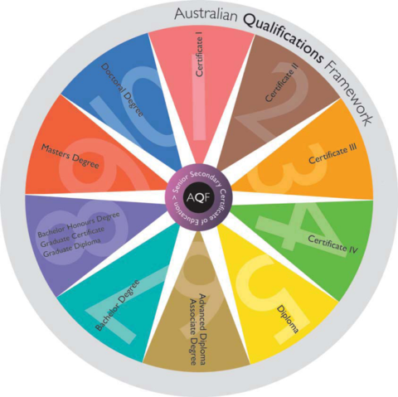


Australian Qualifications Framework - our assessment benchmark
Learning outcomes based
Part of Australia’s quality assurance framework
For information about the Department of Education’s qualification assessments, see www.internationaleducation.gov.au

Slide 7



Our qualitative assessment methodology (in brief)
Education system level
Institution level
Qualification level
  Education governance and administration
  Key economic factors (e.g GDP, education spending)
  Regulation and quality assurance arrangements
  Literacy and numeracy rates
  Student participation and retention rates
  Availability of reliable and verifiable information
  Recognition status in-country
  Institution registration/accreditation
  Establishment of institution
  Independent and internal quality assurance
  Resources (e.g. infrastructure. Staffing and qualifications)
  Research undertakings
  Qualification offerings
  Partnership arrangements
  Program registration/accreditation
  Adherence to national standards
  Entry requirements
  Analysis of program components and requirements, including breadth and depth of study
  Learning outcomes and comparison with the AQF
    knowledge and skills
    application of knowledge & skills
  Credit transfer
  Pathway/s (study or employment)
  Our Country Education Profiles are based on extensive research and analysis. They incorporate this methodology and are aligned with the UNESCO Tokyo Convention.

Slide 8
Our assessment methodology in practice
1. Establish key information about qualifications
2. Identify assessment issue(s)
3. Research issue(s) and document evidence
4. Resolve issue(s) to make a decision
  What is the qualification?
    Name and level
    Date of award
    Awarding institution
    Volume of learning
    Admission requirements
    Program requirements
    Purpose of qualification
    Previous qualification(s)
  What level is the issue?
    Education system
    Institution
    Qualification
  Use the CEP and other authoritative sources
    Document key research results relevant to the identified issue(s)
    Where is it pointing to on the AQF e.g. Bachelor or Associate Degree?
    Use previous cases where available
  Weigh up the information
    Assess the key information and make a decision on balance of all the evidence
    Have you adequately addressed the key issue(s)?
    What are the key risks and how can they be managed?
    Can you defend your decision?

Slide 9


Case study: USA Bachelor degree
Methodology
1. Establish qualification information
4. Resolve issue(s) to make a decision
2. Identify assessment issue(s)
3. Research issue(s) and document evidence
1. Qualification details
  The applicant:
  seeks admission to a Masters of Science at an Australian university
  completed a Bachelor of Science, awarded in 2016 by Salem State University, USA
  also completed a 4-year Licenciada awarded in 2013 by the Superior de Tecnologia de Saude de Lisboa (Portugal)

Slide 10


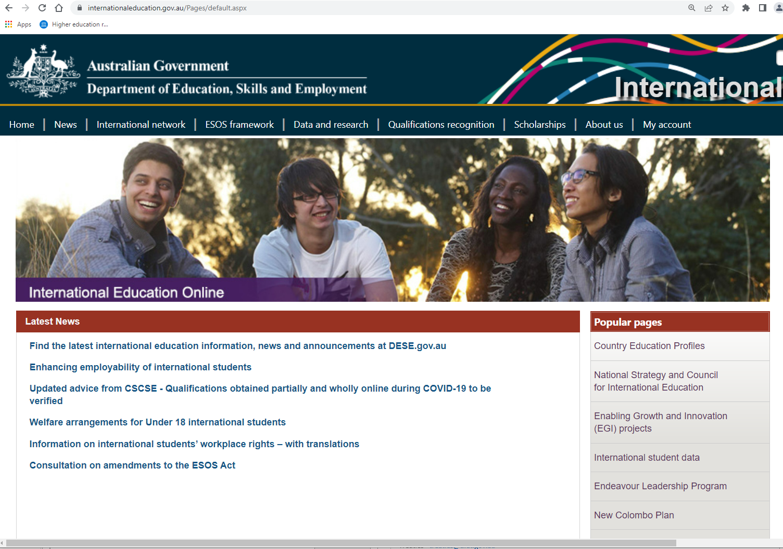
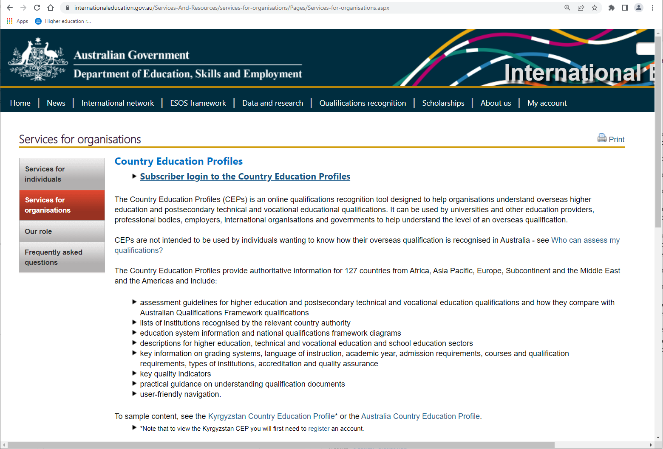
Case study: Assessment of USA Bachelor degree
Methodology
1. Establish qualification information
4. Resolve issue(s) to make a decision
2. Identify assessment issue(s)
3. Research issue(s) and document evidence
Go to www.internationaleducation.gov.au
Username:
Guest3@cep.com
Password:
International1

Slide 11
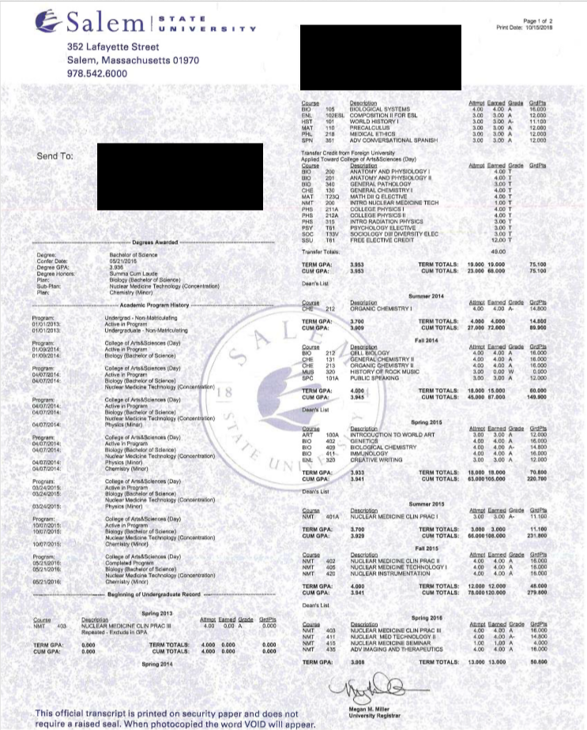
Case study: Assessment of USA Bachelor degree
Methodology
1. Establish qualification information
4. Resolve issue(s) to make a decision
2. Identify assessment issue(s)
3. Research issue(s) and document evidence
4. Resolve issue(s) to make a decision
  Salem State University regionally accredited by
  New England Commission of Higher Education
  For regionally accredited institutions, see USA CEP Assessment guidelines, Higher education, Section 1
  Qualification still meets the general criteria for USA Bachelor degrees for total credits and credits in major area of study despite significant credit transfer granted
  Comparable to AQF Bachelor Degree level (CEP Higher education Assessment guideline #2)

Slide 12
Case study: Key findings and outcome
1. Establish qualification information
4. Resolve issue(s) to make a decision
2. Identify assessment issue(s)
3. Research issue(s) and document evidence
  Qualification details
    Bachelor of Science awarded in 2016 by Salem State University, USA
    Student also completed
    4-year Licenciada from
    Superior de Tecnologia de Saude de Lisboa, Portugal
  Type of issue
Qualification-level issue
Less than 4 years of full time study as significant credit transfer granted from Licenciada
Need to establish if credit transfer granted is reasonable for this qualification (does not substantially affect on education outcomes)
  Research undertaken
    Confirmed that institution is recognised by relevant authority in USA
    USA CEP assessment guideline requires Bachelor Degrees to have 120 semester credits
    Confirmed that Portuguese institution and qualification is recognised by relevant authority in Portugal
    Portuguese program is coherent and relevant for credit transfer into the USA qualification
  Resolution of issues and outcome
    University regionally accredited in USA by New England Commission of Higher Education
    As a regionally accredited institution, refer to the USA CEP HE Section 1 Assessment guidelines
    Qualification meets the general criteria for USA Bachelor degrees in term of total credits and credits in major area of study
    Qualification is comparable to AQF Bachelor Degree level (Assessment guideline #2)

Slide 13

Key points
Establish your qualifications recognition framework and approach for your specific purpose (e.g. student admissions, employment)
Establish your benchmark and develop assessment policies, ensure transparency
Develop a flexible assessment methodology (qualitative over quantitative) that supports student mobility (Tokyo Convention), manages differences in overseas qualifications and maintains quality standards

